Slide 1
Tableau
Tableau Visual Analysis

Slide 2
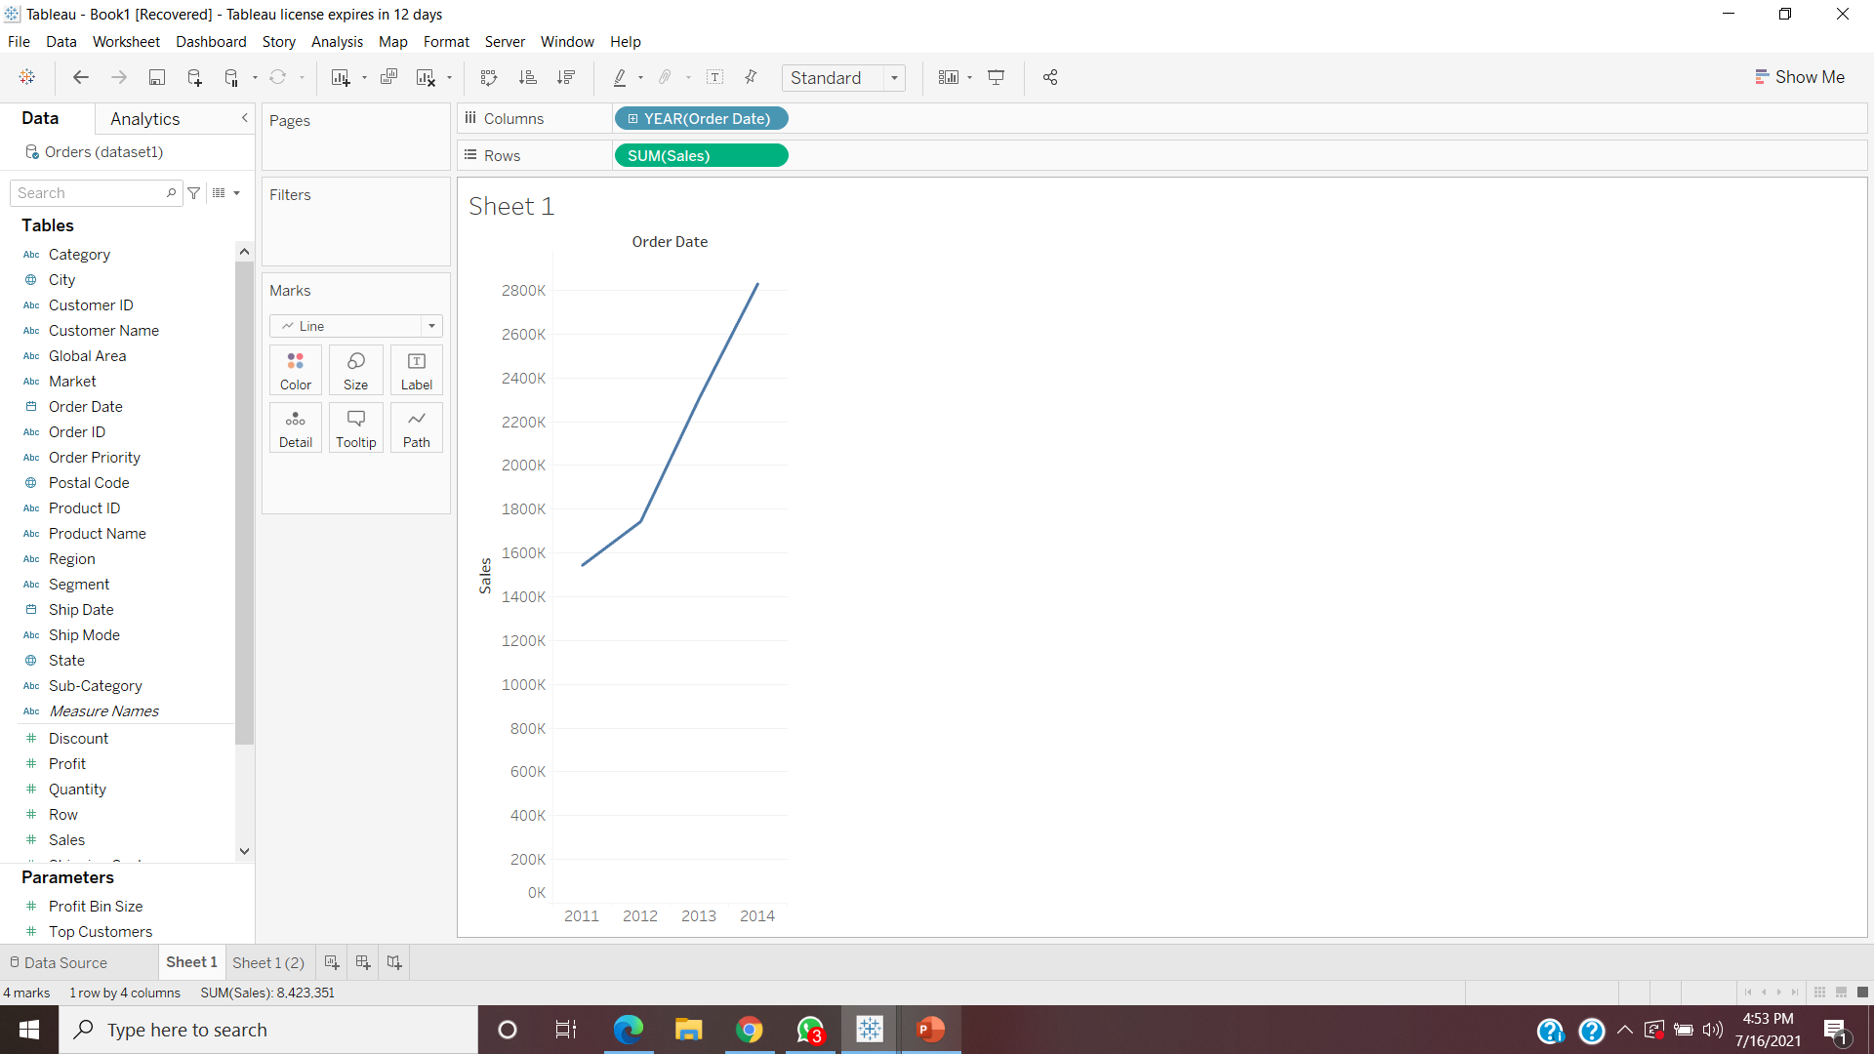
Find total aggregated sales for each year by order date.

Slide 3

In which years sales was minimum and maximum
Minimum Sales- 2011
Maximum Sales-2014

Slide 4
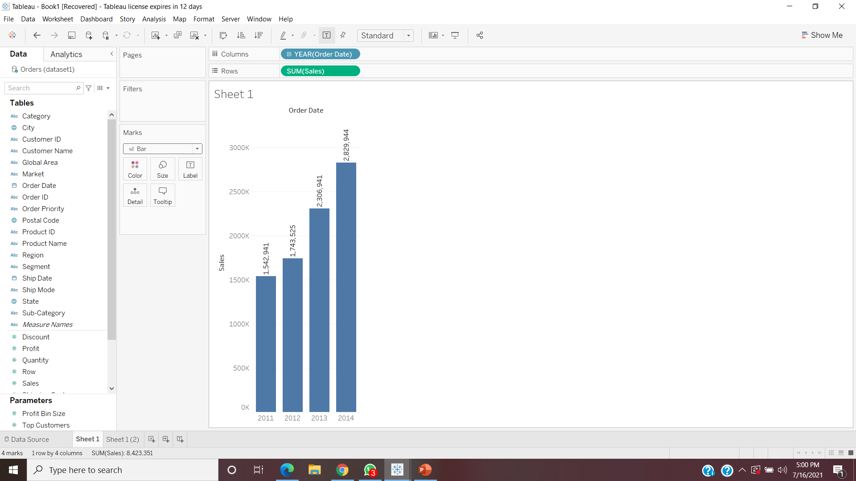
Find the highest sales and show the view in bar graph and label it

Slide 5
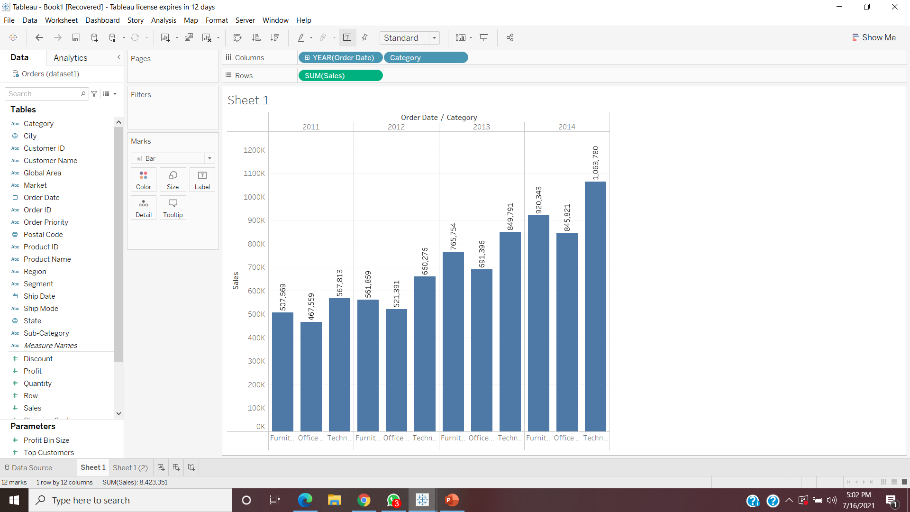
Find the category wise sales for every year

Slide 6
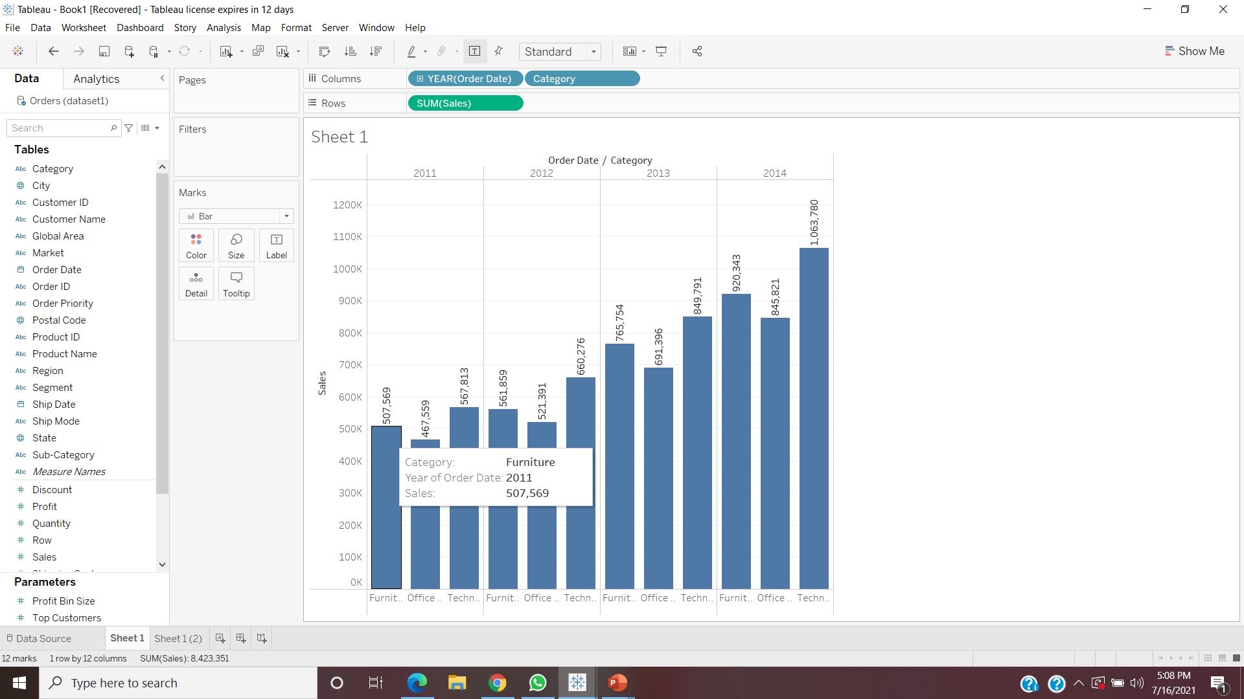
Check the tooltip for sales for every category.

Slide 7
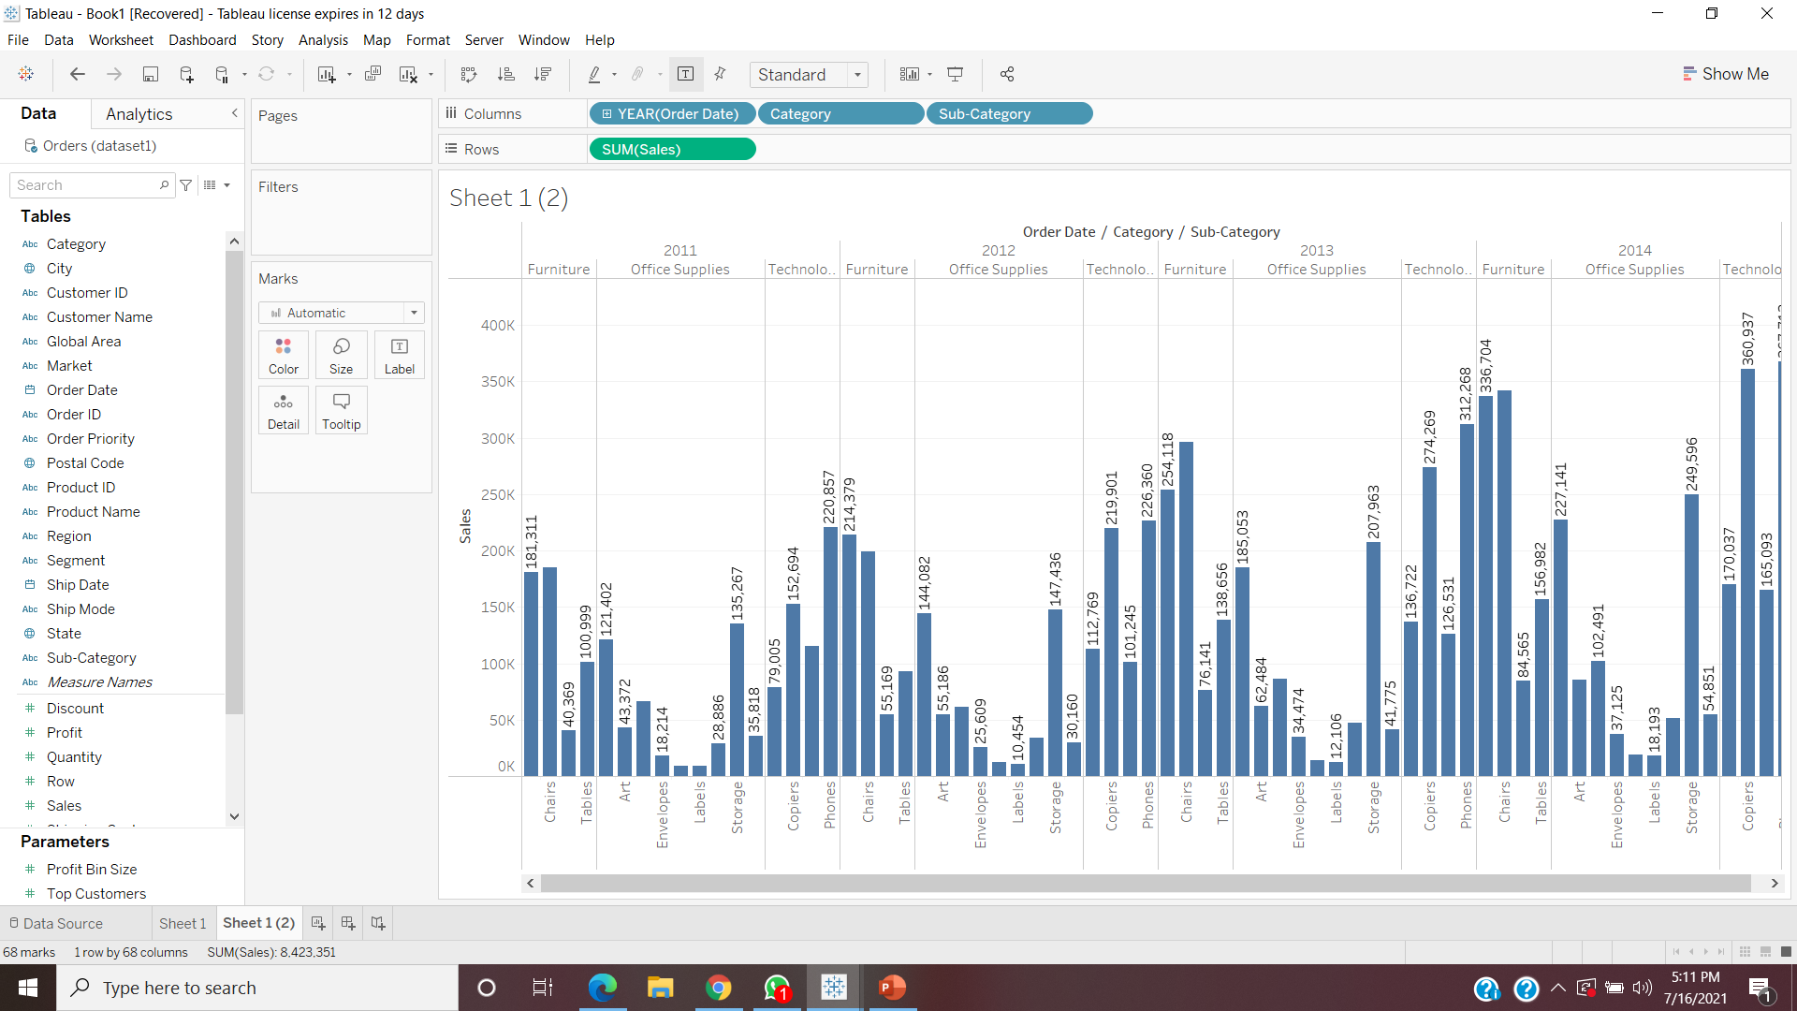
Display subcategory and find some insights from the view about max and min sales under every category.

Slide 8
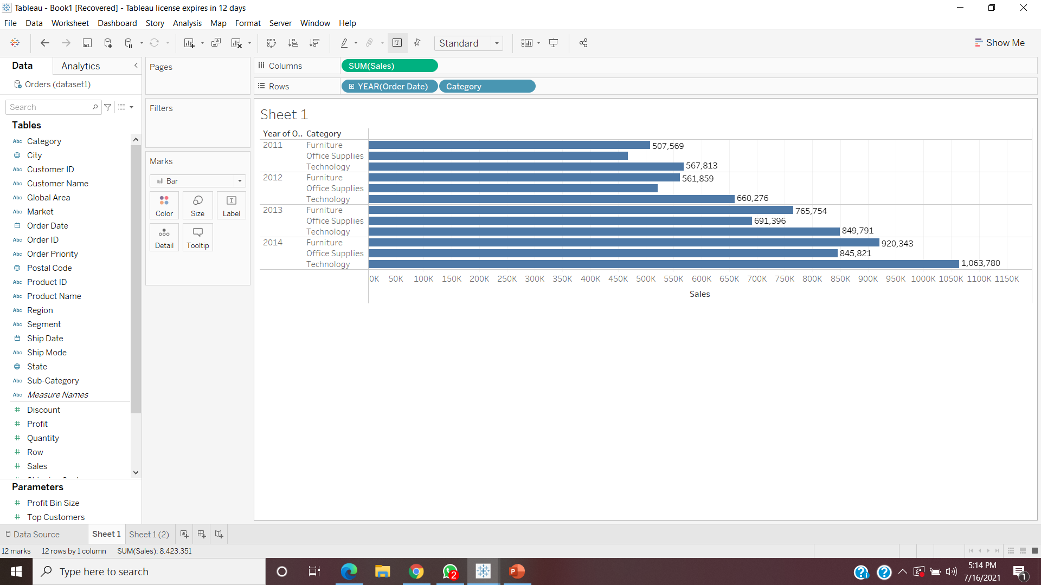
Swap rows and columns using appropriate option and display the view horizontally.

Slide 9
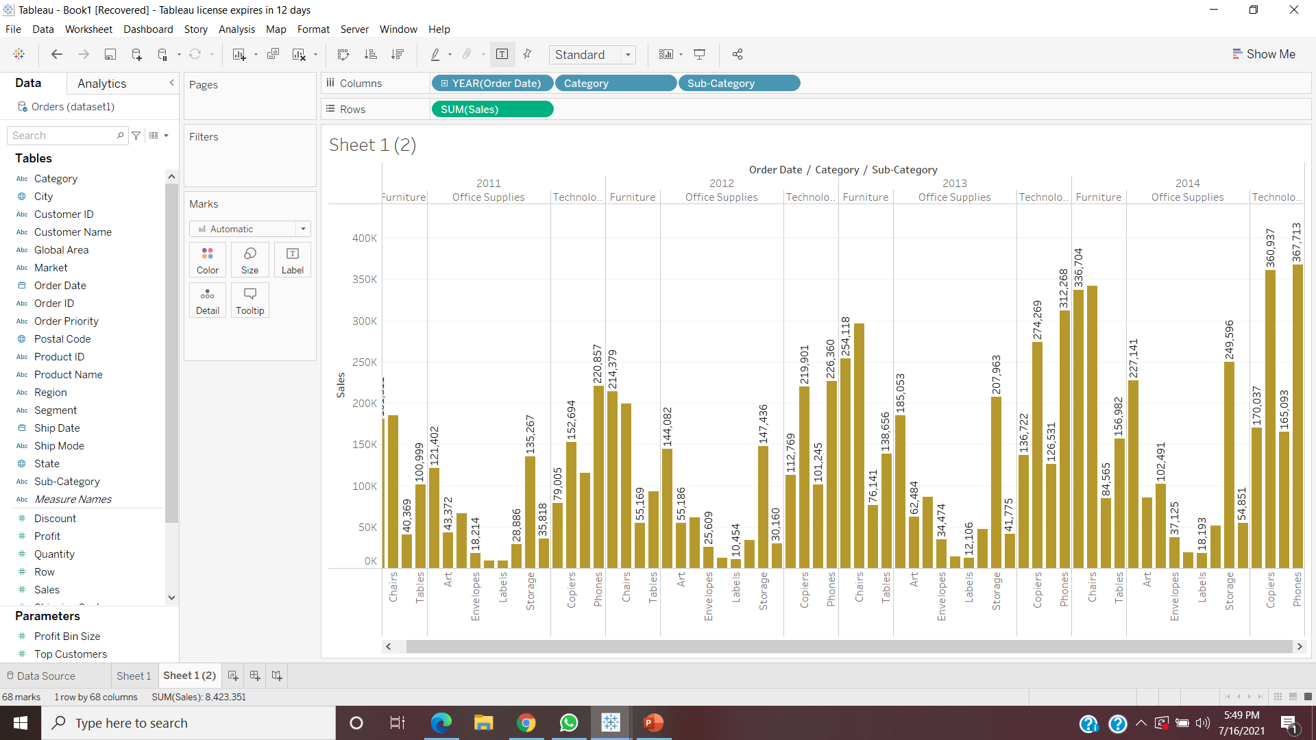
Represent your view using different color

Slide 10
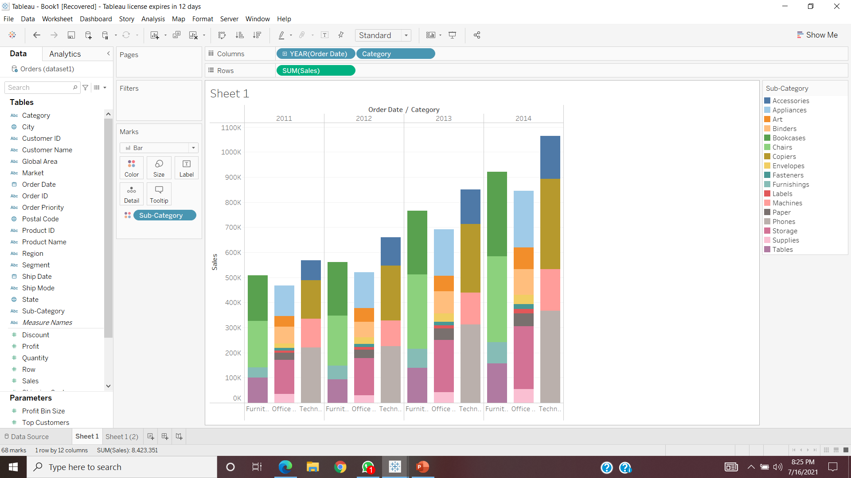
Use color cart to show subcategory under every category.

Slide 11
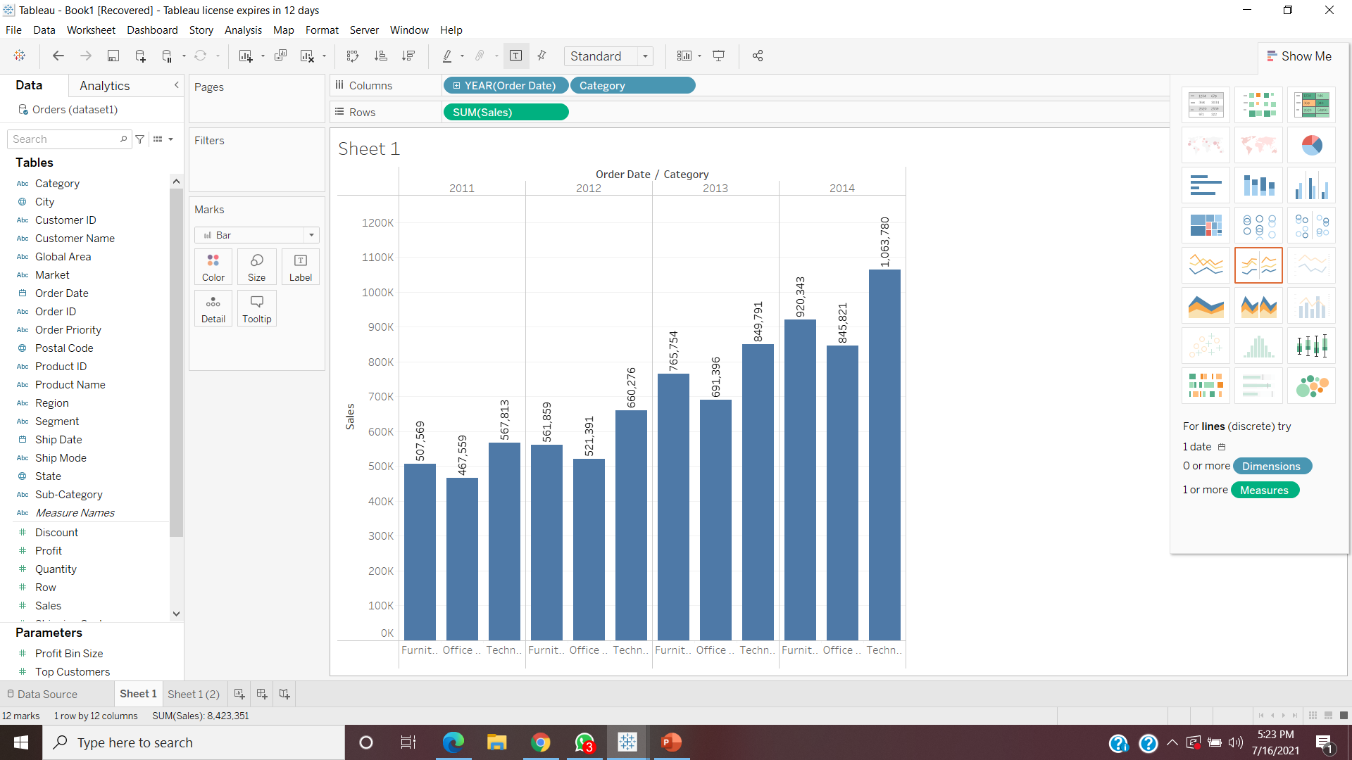
Which category has highest sales in every year?
2011-Technology
2012-Technology
2013-Technology
2014-Technology

Slide 12
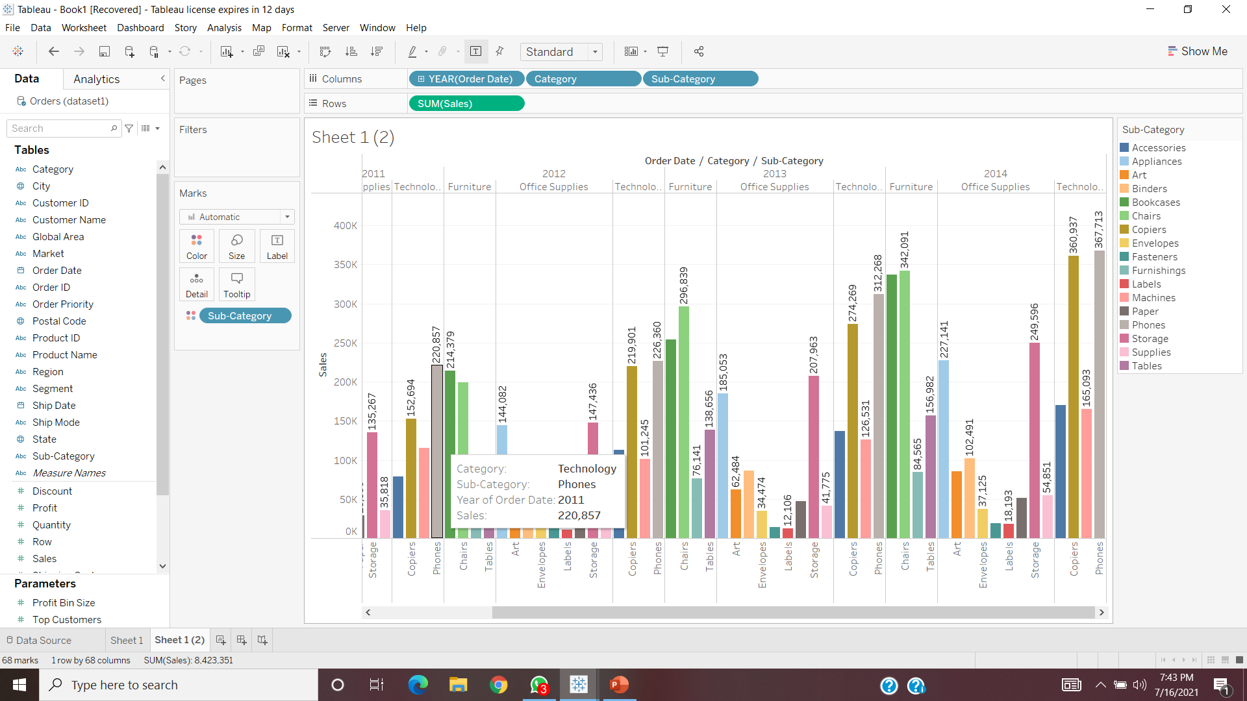

What is the total sales of machine and phones type subcategory in the year 2011.
Total Sales of machine and phones = 336,115

Slide 13
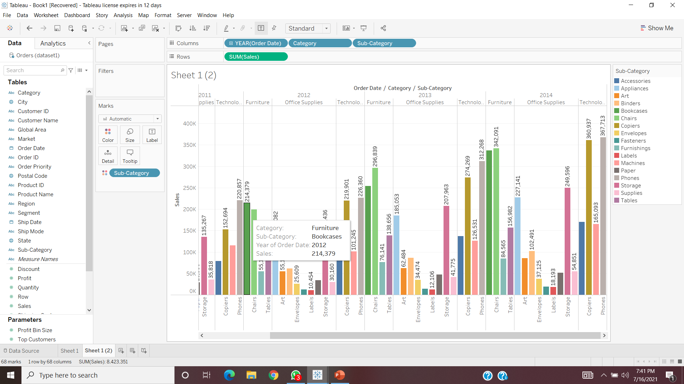
Which subcategory of furniture type category has highest sales in 2011.
Bookcases has highest sales in 2011

Slide 14
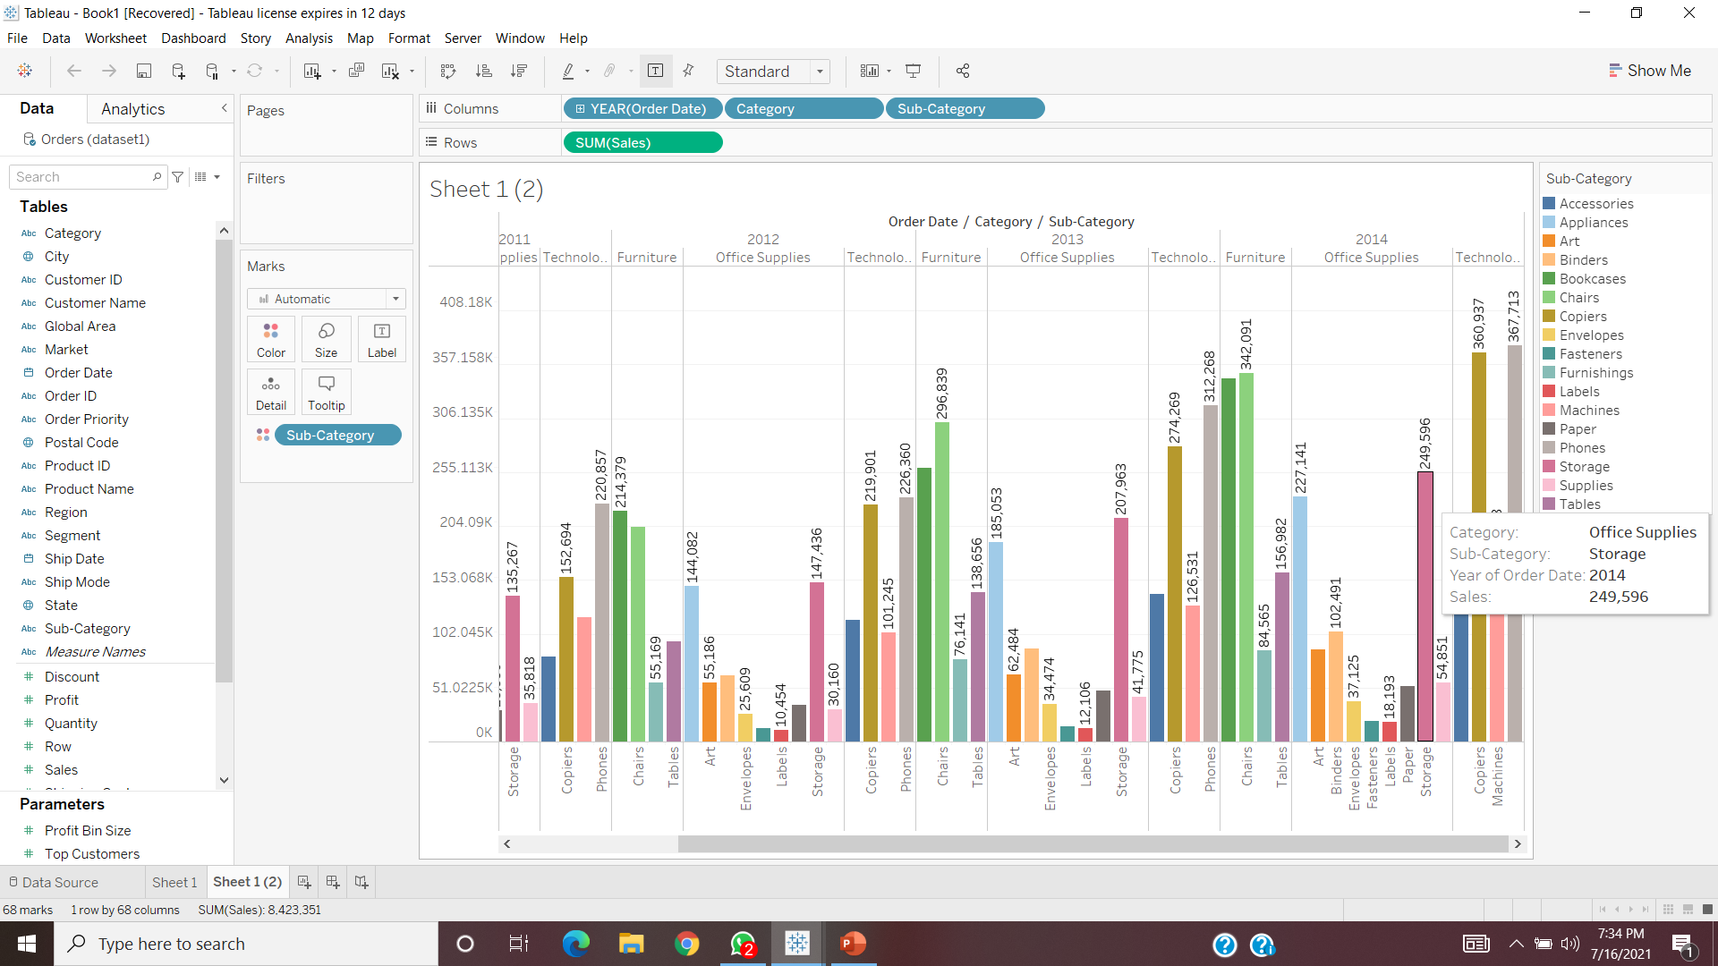


In the year 2014 which subcategory has highest sales under each category.

Slide 15
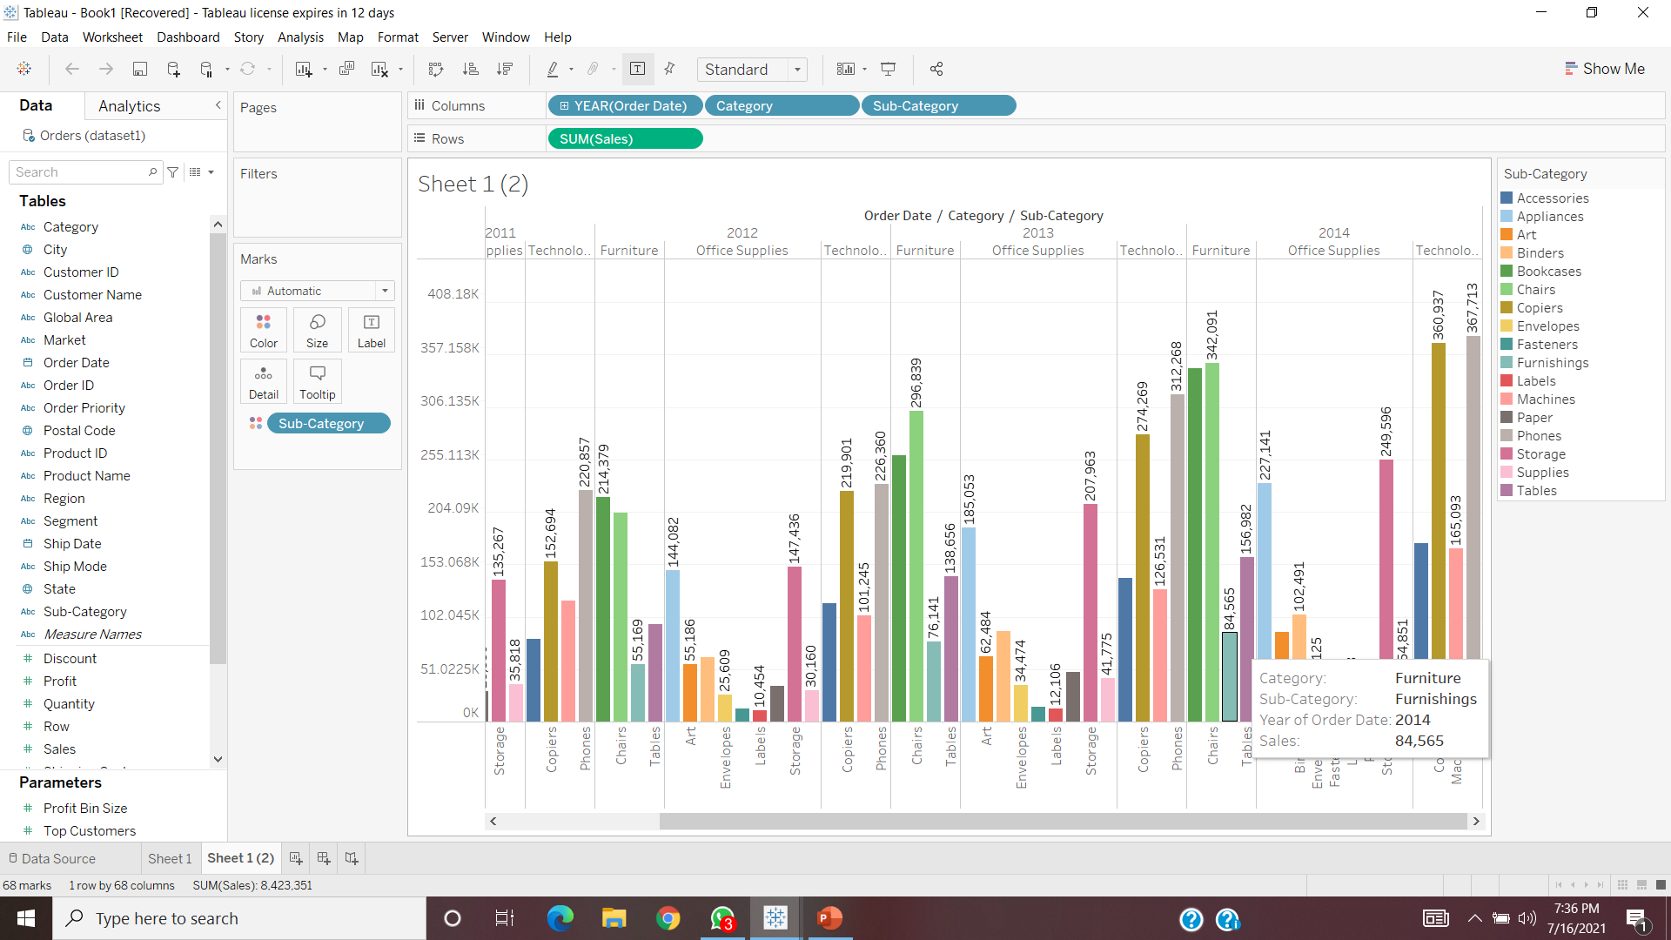

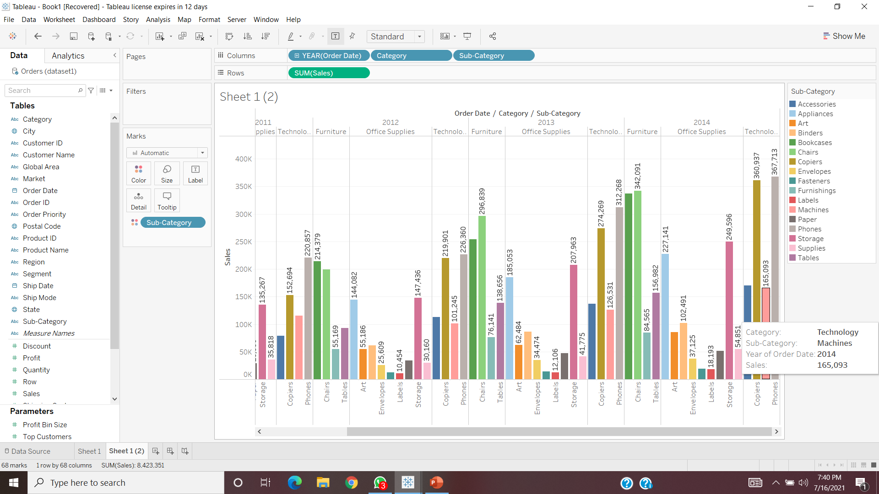
In the year 2014 which subcategory has lowest sales under each category

Slide 16
What decision you can take to increase the profit in the next year based on Your current years analysis.
As we can see from the visualization, the ratio of sales were increased every year for category Technology.
To increase the profit for next year we can increase the manufacturing in Category technology of phones.

